Slide 1
C++ is Fun – Part Three at Turbine/Warner Bros.!
Russell Hanson

Slide 2
Let’s go over homework!
Hope you enjoyed the homework, you did, right? Right, guys?

Slide 3
Cool.

Slide 4
Homework! :?
Notes on system(“PAUSE”) and endl vs. “\n”
cout << first <<'\n';
// cout << first << endl;
system("PAUSE");
return 0;
}
$ ./PartDeux.exe
Enter two words:
Big Apple
Press any key to continue . . .
Big Ripe Apple
cout << first <<'\n';
// cout << first << endl;
// system("PAUSE");
return 0;
}
$ ./PartDeux.exe
Enter two words:
Big Apple
Big Ripe Apple
// cout << first <<'\n';
cout << first << endl;
system("PAUSE");
return 0;
}
$ ./PartDeux.exe
Enter two words:
Big Apple
Big Ripe Apple
Press any key to continue . . .

Slide 5
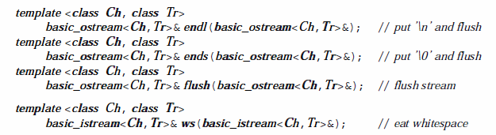

Slide 6
As you may recall, “Homework for next Monday (pick 2, minimum)”
Write a program that uses the modulus operator to determine if a number is odd or even. If the number is evenly divisible by 2, it is an even number. A remainder indicates it is odd. The number can be input by the user or read from a file.
Write an if statement that performs the following logic: if the variable sales is greater than 50,000, then assign 0.25 to the commissionRate variable, and assign 250 to the bonus variable.
Accept two strings as input at the prompt/command line, such as “Big” and “Apple.” Join or concatenate the two words with a third word, such as “Ripe” and print the three words together with the third word the middle, “Big Ripe Apple”.
Accept 5 integers on the command line, either all at once or separately. Save these to an array, vector, or list. Print the integers in the range 2 through 4, leaving off the first and the last. Bonus: Ask for the size of the array to be used, so it can be 5, 6, or 7 etc. Double Bonus: Allow a variable number of input numbers, stop input using a stop character or command the letter “s” say, then print all the input integers leaving off the first and the last.

Slide 7
1) Write a program that uses the modulus operator to determine if a number is odd or even. If the number is evenly divisible by 2, it is an even number. A remainder indicates it is odd. The number can be input by the user or read from a file.
string oddOrEven(int number)
{
string answer = "";
if(number % 2 == 0) {
answer = "even";
}
else {
answer = "odd";
}
return answer;
}
void questionOne()
{
int number = 0;
cout << "Please enter your number. I will determine if it is odd or even." << endl;
cin >> number;
string answer = oddOrEven(number);
cout << "The number you entered is: " << answer << endl;
}
// int main
if(questionToAnswer == 1)
{
questionOne();
}

Slide 8
2) Write an if statement that performs the following logic: if the variable sales is greater than 50,000, then assign 0.25 to the commissionRate variable, and assign 250 to the bonus variable.
void questionTwo()
{
int sales = 0;
double commissionRate = 0;
int bonus = 0;
cout << "Please enter the sales amount for the year:" << endl;
cin >> sales;
if(sales > 50000)
{
commissionRate = 0.25;
bonus = 250;
}
cout << "Your sales commission rate is: " << commissionRate << endl;
cout << "Your bonus is: " << bonus << endl;
}

Slide 9
3) Accept two strings as input at the prompt/command line, such as “Big” and “Apple.” Join or concatenate the two words with a third word, such as “Ripe” and print the three words together with the third word the middle, “Big Ripe Apple”.
string concatenate(string first, string second, string middle)
{
stringstream ss;
ss << first << " " << middle << " " << second;
string s = ss.str();
return s;
}
void questionThree()
{
string firstWord;
string secondWord;
string middleWord;
cout << "Please enter a word:" << endl;
cin >> firstWord;
cout << "Please enter a second word:" << endl;
cin >> secondWord;
cout << "Please enter a word to put in the middle:" << endl;
cin >> middleWord;
string phrase = concatenate(firstWord, secondWord, middleWord);
cout << "Your final sentence is: " << phrase << endl;
}

Slide 10
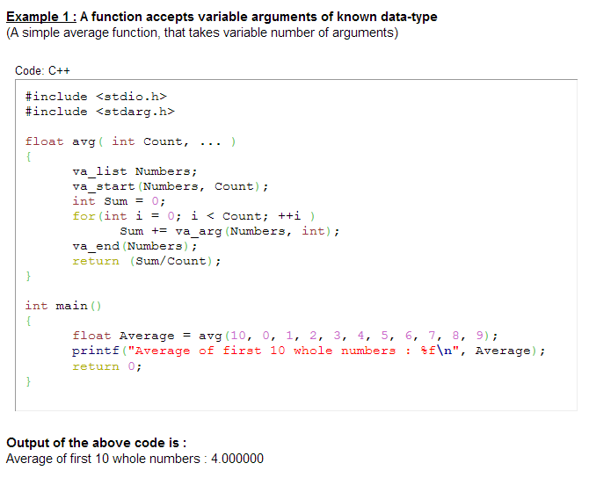
Functions with variable length arguments

Slide 11
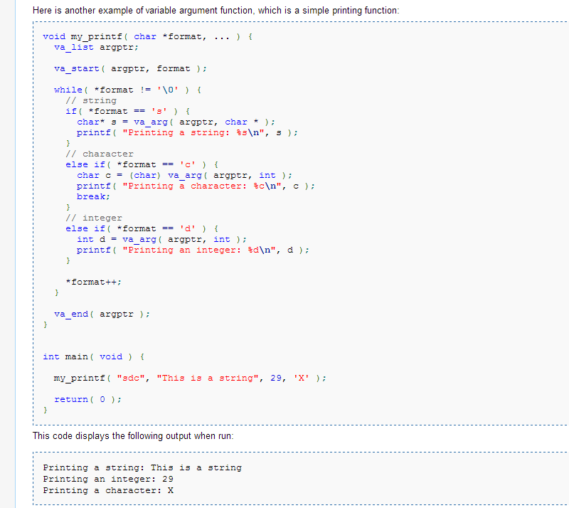

Slide 12
4) Accept 5 integers on the command line, either all at once or separately. Save these to an array, vector, or list. Print the integers in the range 2 through 4, leaving off the first and the last. Bonus: Ask for the size of the array to be used, so it can be 5, 6, or 7 etc. Double Bonus: Allow a variable number of input numbers, stop input using a stop character or command the letter “s” say, then print all the input integers leaving off the first and the last.
void questionFour()
{
int dataStructChosen;
cout << "Welcome to store and retrieve numbers. Would you like to store numbers in 1) an array, 2) a vector, or 3) a list?" << endl;
cin >> dataStructChosen;
if(dataStructChosen == 1)
{
int size = 5;
do
{
cout << "What size array would you like to use? (select a size of 5 or greater please)" << endl;
cin >> size;
} while(size < 5);
int *myArray = new int[size];
for(int i = 0; i <= size - 1; i++)
{
int number;
cout << "Please enter a number " << ":" << endl;
cin >> number;
myArray [i] = number;
}
cout << "Here are the values from position 2 to " << size - 1 << ": " << endl;
for(int j = 0; j < size - 2; j++)
{
cout << "The array value at position " << j+2 << " is: " << myArray[j+1] << endl;
}
}

Slide 13
else if (dataStructChosen == 2)
{
int size = 5;
do
{
cout << "What size vector would you like to use? (select a size of 5 or greater please)" << endl;
cin >> size;
} while(size < 5);
vector<int> myVector;
for(int i = 0; i <= size - 1; i++)
{
int number;
cout << "Please enter a number:" << endl;
cin >> number;
myVector.push_back(number);
}
cout << "Here are the values from position 2 to " << size - 1 << ":" << endl;
for(int j = 0; j < size - 2; j++)
{
cout << "The vector value at position " << j + 2 << " is: " << myVector[j+1] << endl;
}
}

Slide 14
else if (dataStructChosen == 3){
int size = 5;
do
{
cout << "What size list would you like to use? (select a size of 5 or greater please)" << endl;
cin >> size;
} while(size < 5);
list<int> myList;
for(int i = 0; i <= size - 1; i++)
{
int number;
cout << "Please enter a number:" << endl;
cin >> number;
myList.push_back(number);
}
cout << "Here are the values from position 2 to " << size - 1 << ":" << endl;
for(list<int>::iterator it=myList.begin(); it != myList.end(); it++)
{
if(it == myList.begin())
{
continue;
}
if(next(it) == myList.end())
{
continue;
}
else
{
cout << "The list value at position is: " << (*it) << endl;
}
}
}

Slide 15
The ‘+’ operator can concatenate strings, not strings and ints
int main() {
std::string a = "Hello ";
std::string b = "World";
std::string c = a + b;
// std::string c = a + b + 3 + "4" + "hello"; // Doesn't work
// 23 IntelliSense: no operator "+" matches these operands
// operand types are: std::basic_string<char, std::char_traits<char>,
// std::allocator<char>> + int
cout << c << endl;
int myInt = 3;
std::stringstream ss;
ss << a << b << myInt << 4 << "hello";
string newstring = ss.str();
cout << newstring << endl;
}

Slide 16
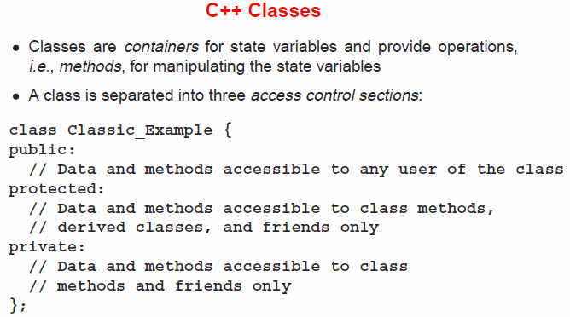
2) Objects, encapsulation, abstract data types, data protection and scope

Slide 17
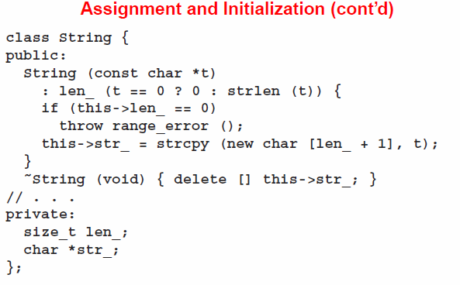

Slide 18
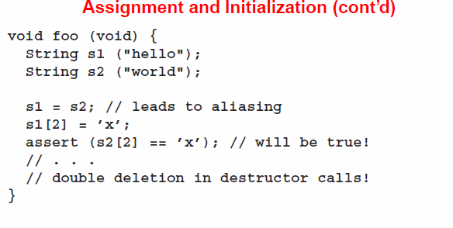
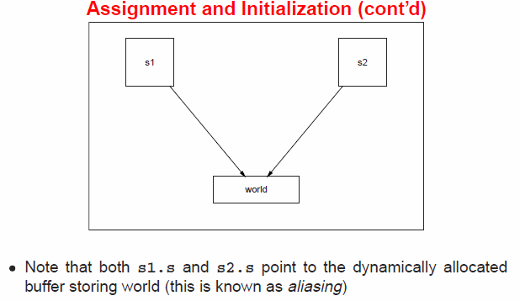

Slide 19
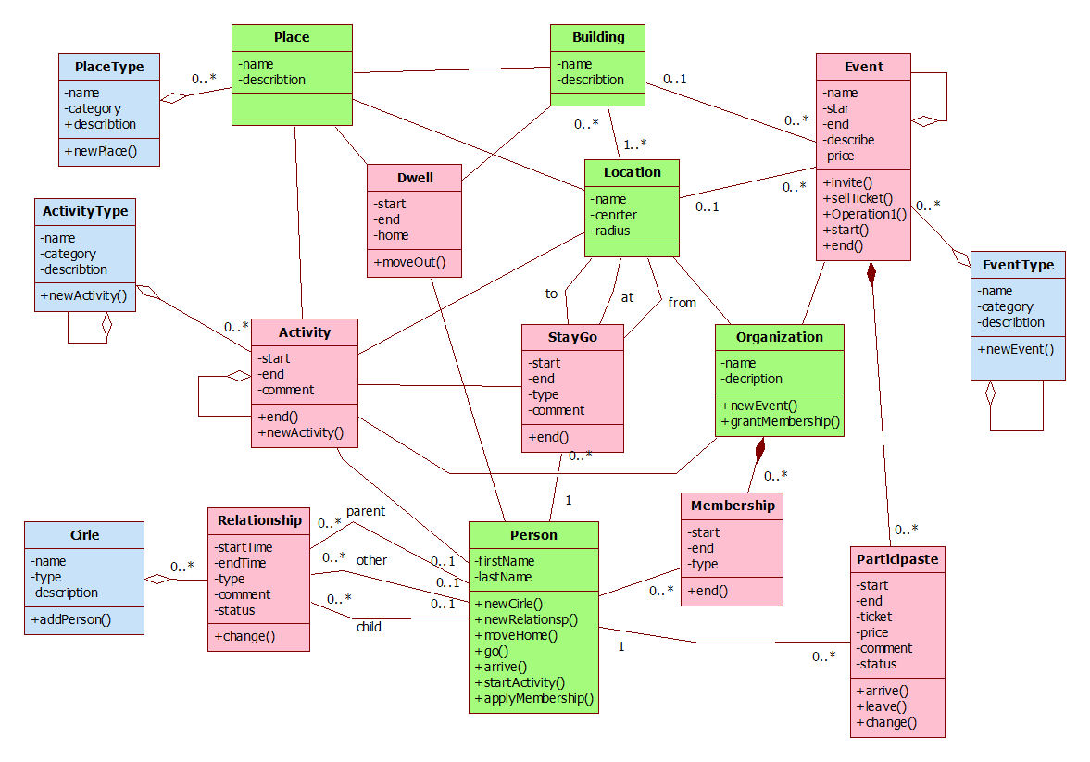
“Objects” and “Classes” ??

Slide 20
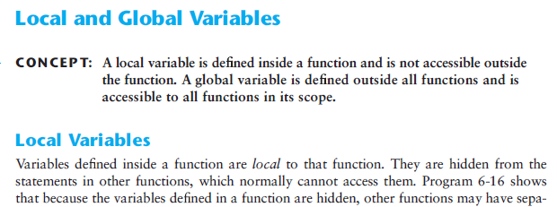
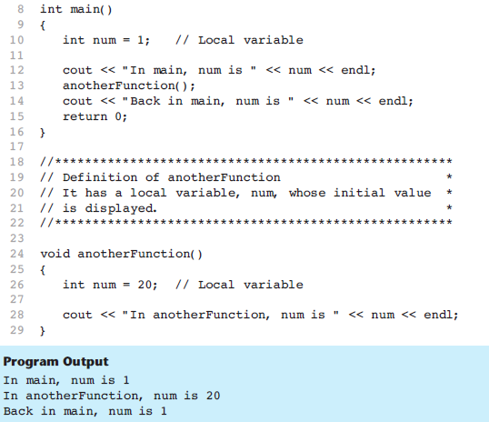

Slide 21
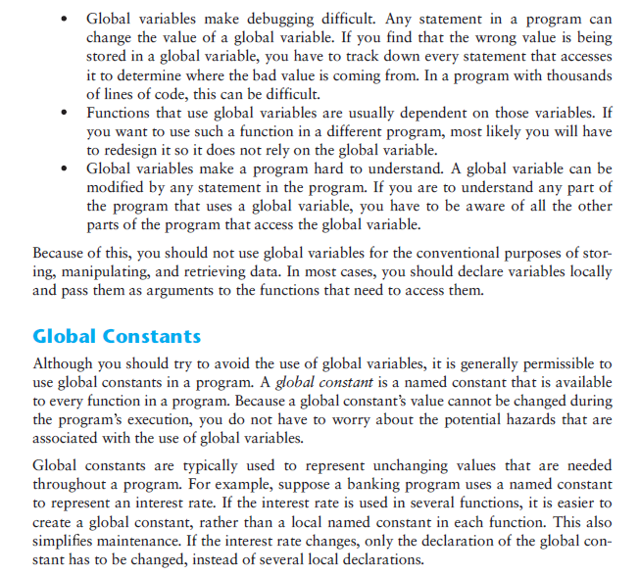
Global Variables vs. Global Constants

Slide 22
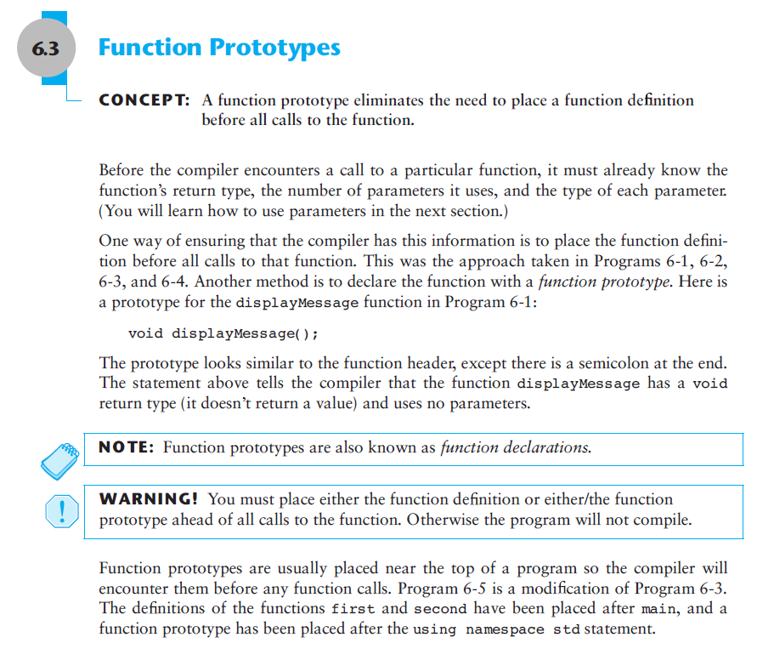

Slide 23
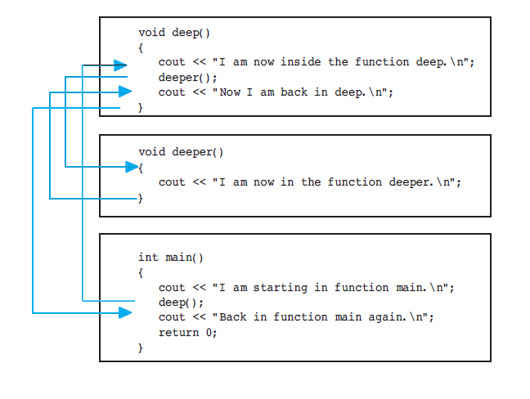

Slide 24
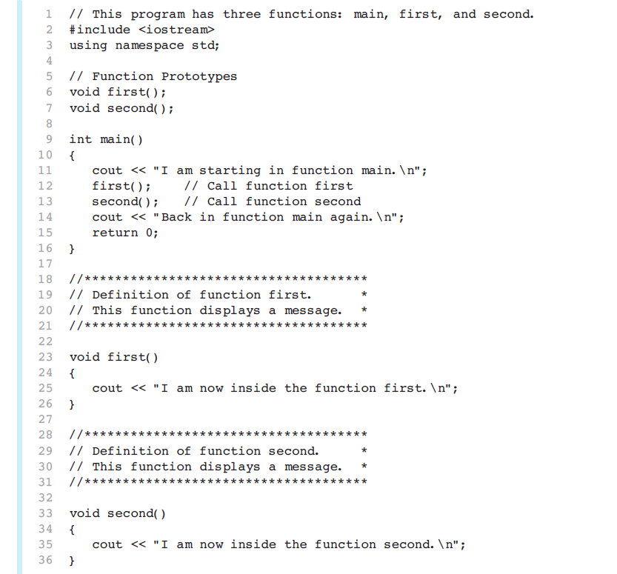

Slide 25
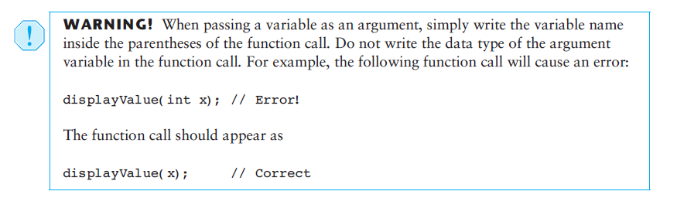

Slide 26
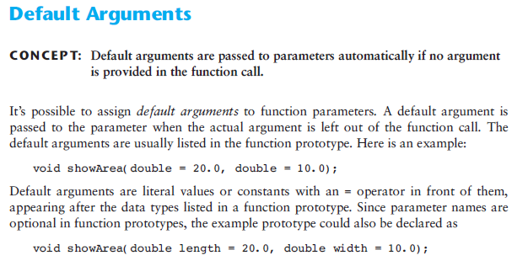
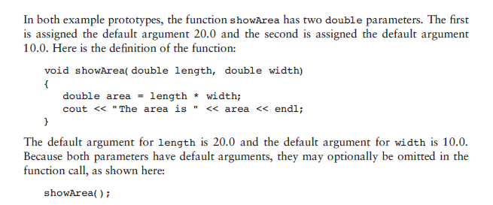

Slide 27
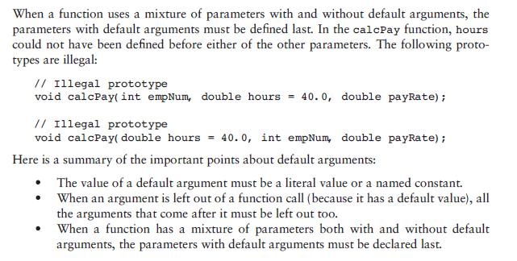

Slide 28
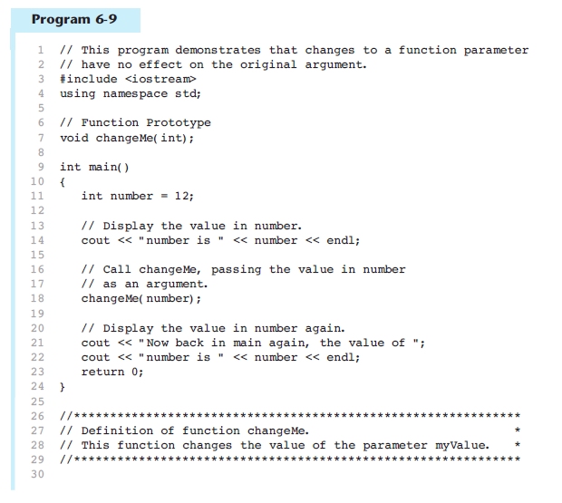
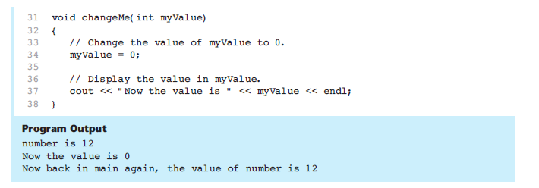

Slide 29
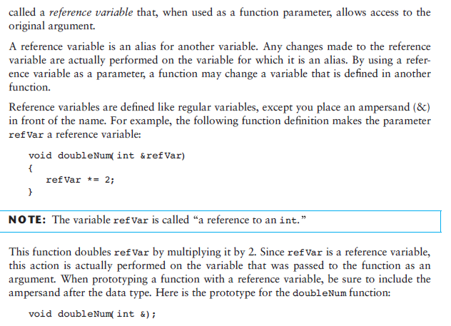
Using reference variable as parameters

Slide 30
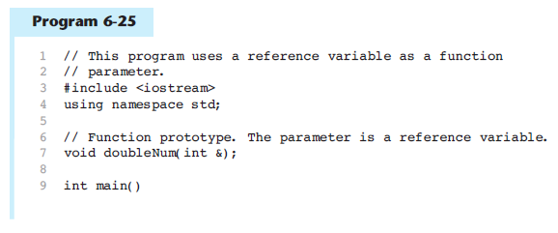
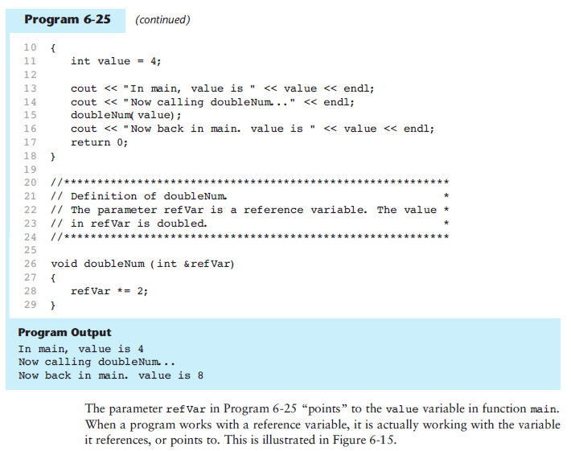

Slide 31
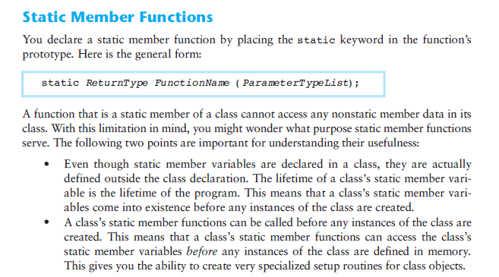

Slide 32
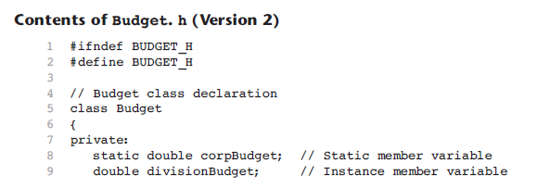
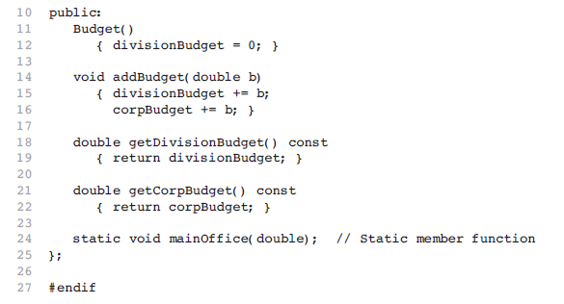

Slide 33
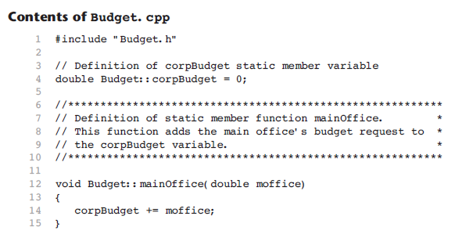

Slide 34
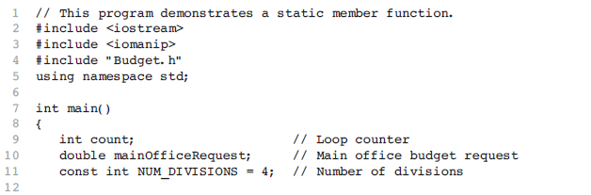
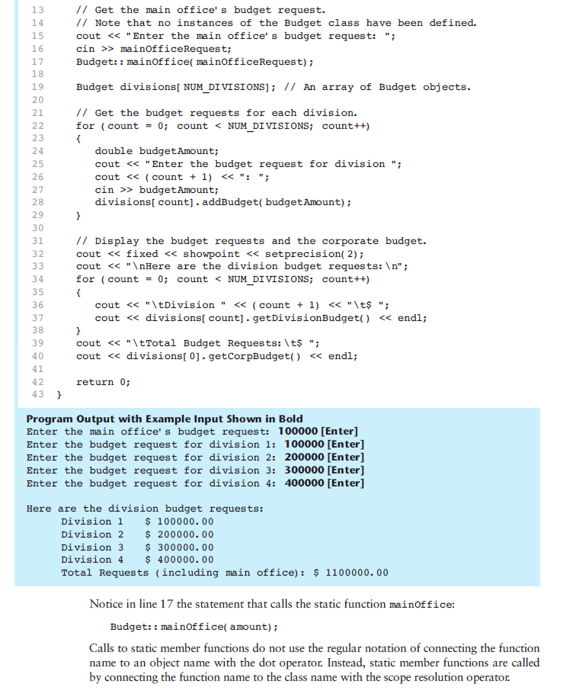

Slide 36
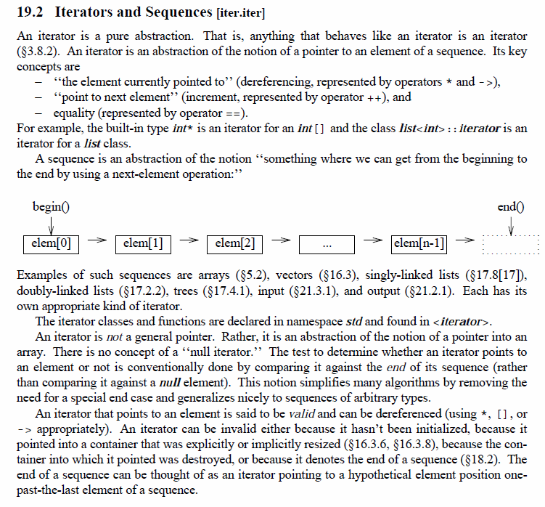

Slide 37
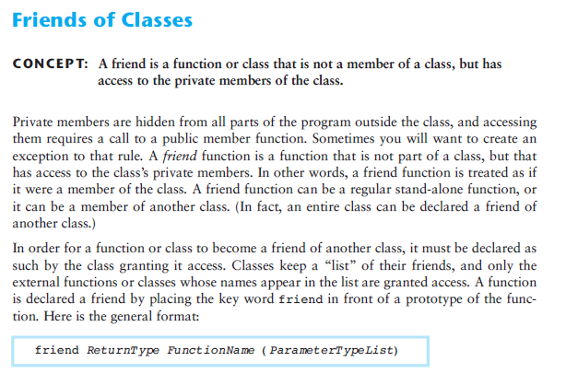
In Java, we refer to the fields and methods of a class. In C++, we use the terms data members and member functions. Furthermore, in Java, every method must be inside some class. In contrast, a C++ program can also include free functions - functions that are not inside any class.
main () is a free function in C++

Slide 38
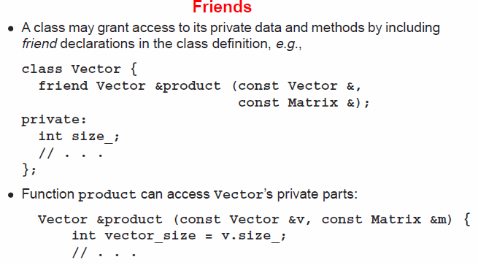

Slide 39
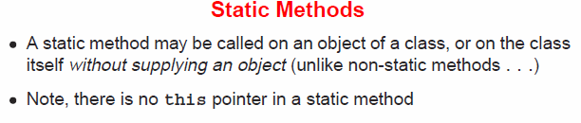
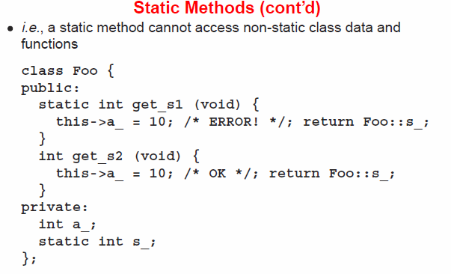

Slide 40
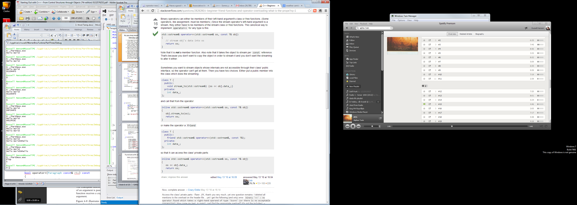
Operator Overloading

Slide 42
#include <iostream>
#include <sstream>
#include <string>
using namespace std;
class Paragraph
{
public:
Paragraph(std::string const& init)
:m_para(init)
{}
std::string const& to_str() const
{
return m_para;
}
bool operator==(Paragraph const& rhs) const
{
return m_para == rhs.m_para;
}
bool operator!=(Paragraph const& rhs) const
{
// Define != operator in terms of the == operator
return !(this->operator==(rhs));
}
bool operator<(Paragraph const& rhs) const
{
return m_para < rhs.m_para;
}
private:
friend std::ostream & operator<<(std::ostream &os, const Paragraph& p);
std::string m_para;
};
std::ostream & operator<<(std::ostream &os, const Paragraph& p)
{
return os << p.to_str();
}
int main()
{
Paragraph p(“My Paragraph");
Paragraph q(p);
std::cout << p << std::endl << (p == q) << std::endl;
}
$ ./Paragraph.exe
My Paragraph
1

